Slide 1

Database Fundamentals
Mrihan Mohamed Ahmed
Teacher Assistant – ITI
mrihan.m.ahmed@gmail.com

Slide 2
File-based System
In your opinion, what are the problems of the previous two types?
Delimited File
Fixed Width File
-
x
-
x
Mohamed,26,Minia|Ali,27,Minia|Ramy,22,Cairo|Roaa,27,Aswan|Sally,28,Alex|Nader,30,Cairo|
3 Bytes name, 2 Bytes age & 3 Bytes City

Slide 3
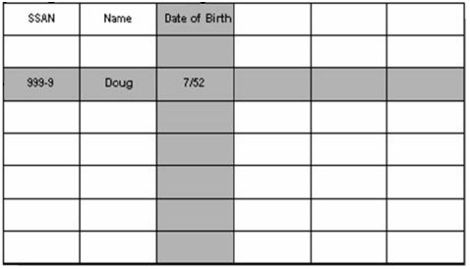
Database System
A data structure through which data is stored in tables that are related to one another in some way.
The way the tables are related is described through a relationship.
Column
Row
Instance

Slide 4
Database Life Cycle
Requirement Analysis
Logical Design
Physical Design
Implementation
Monitoring & Maintenance

Slide 5
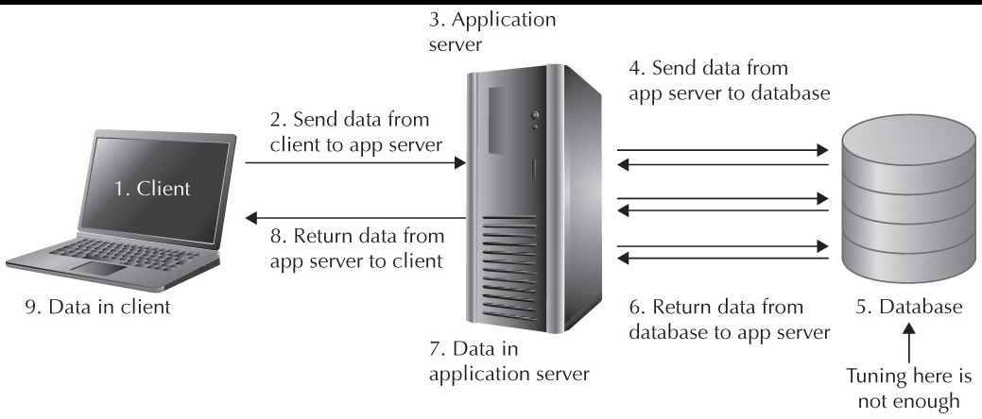
How Application Accesses DB?

Slide 6
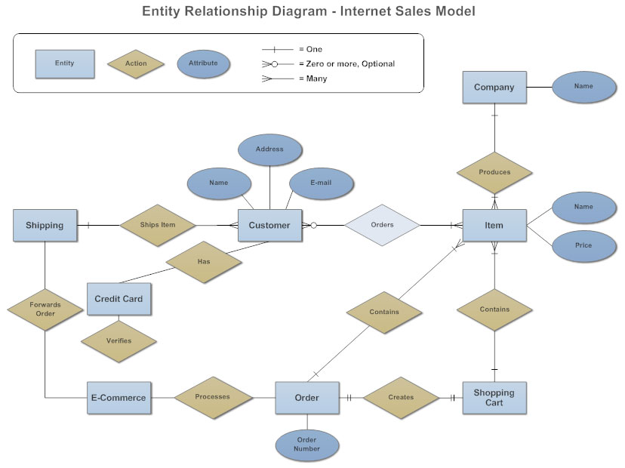
Entity Relationship Diagram (ERD)
It works around real-world entities and the associations among them.
It identifies information required by the business by displaying the relevant entities and the relationships between them.

Slide 7
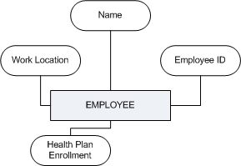
Entity Relationship Diagram (ERD)
Entity:
An entity can be a real-world object, either animate or inanimate.
For example, in a school database, students.
An entity set is a collection of similar types of entities.
Attribute:
Entities are represented by means of their properties.
All attributes have values.
There exists a domain or range of values that can be assigned to attributes.

Slide 8
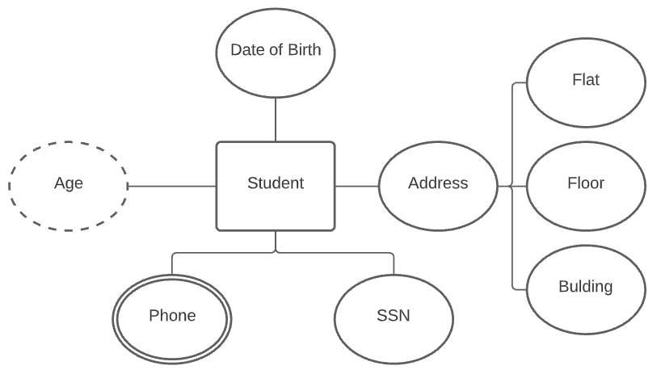
Entity Relationship Diagram (ERD)
Attribute Types:
Notes:
Simple attribute: Simple attributes are atomic values, which cannot be divided further. For example, a student's phone number is an atomic value of 10 digits.
Composite attribute: Composite attributes are made of more than one simple attribute. For example, a student's complete name may have first_name and last_name.
Derived attribute: Derived attributes are the attributes that do not exist in the physical database, but their values are derived from other attributes present in the database. For example, average_salary in a department should not be saved directly in the database, instead it can be derived. For another example, age can be derived from data_of_birth.
Single-value attribute: Single-value attributes contain single value. For example − Social_Security_Number.
Multi-value attribute: Multi-value attributes may contain more than one values. For example, a person can have more than one phone number, email_address, etc.
This can be combined:
simple single-valued attributes
simple multi-valued attributes
composite single-valued attributes
composite multi-valued attributes

Slide 9

Entity Relationship Diagram (ERD)
Key: it is an attribute or collection of attributes that uniquely identifies an entity among entity set.
Candidate Key − A minimal super key is called a candidate key. An entity set may have more than one candidate key.
Primary Key − A primary key is one of the candidate keys chosen by the database designer to uniquely identify the entity set.
Foreign Keys : Foreign keys reference a related table through the primary key of that related table.
Referential Integrity Constraint: For every value of a foreign key there is a primary key with that value in the referenced table.

Slide 10

Relationships
The association among entities is called a relationship. For example, an employee works_at a department, a student enrolls in a course.
A set of relationships of similar type is called a relationship set. Like entities, a relationship too can have attributes. These attributes are called descriptive attributes.
Notes:
Degree of Relationship: The number of participating entities in a relationship defines the degree of the relationship.
Binary = degree 2
Ternary = degree 3
n-ary = n-degree

Slide 11
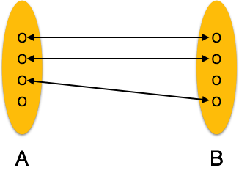
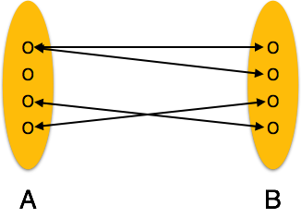
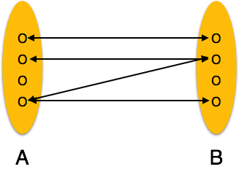
Relationships
One to One:
One entity from entity set A can be associated with at most one entity of entity set B and vice versa.
One-to-many:
One entity from entity set A can be associated with more than one entities of entity set B however an entity from entity set B, can be associated with at most one entity.
Many-to-many:
One entity from A can be associated with more than one entity from B and vice versa.

Slide 12
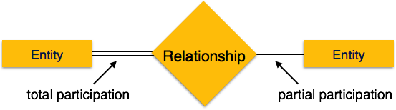
Relationships
Participation Constraints
Total Participation: Each entity is involved in the relationship. Total participation is represented by double lines.
Partial participation: Not all entities are involved in the relationship. Partial participation is represented by single lines.

Slide 13
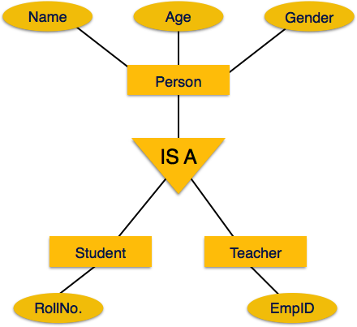
Relationships
Is-A Relation:
Inheritance is an important feature of Generalization and Specialization. It allows lower-level entities to inherit the attributes of higher-level entities.

Slide 14
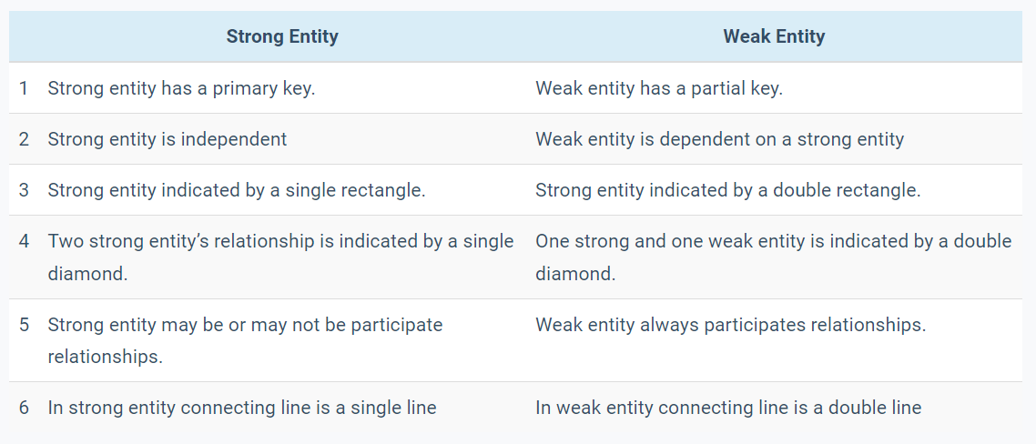
Weak Entity

Slide 15
ERD Notations
 | Entity |  | Attribute
 | Weak Entity |  | Key Attribute
 | Relation |  | Derived Attribute
 | Weak Relation |  | Multi-Valued Attribute
 |  |  | Relationships
M
1

Slide 16
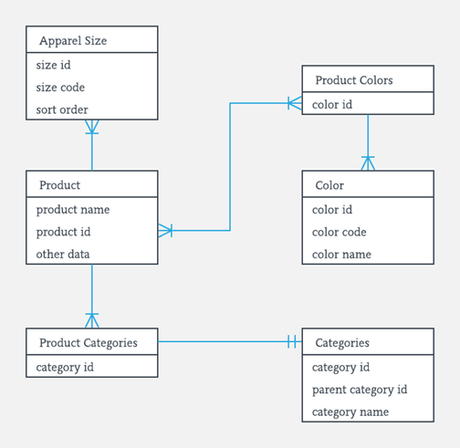
Mapping
Step 1: Mapping of Regular Entity Type
Step 2: Mapping of Weak Entity Type
Step 3: Mapping of Binary 1:1 Relation
Step 4: Mapping of Binary 1:M Relation
Step 5: Mapping of Binary M:M Relation
Step 6: Mapping of Trinary Relation
Step 7: Mapping of Unary Relation

Slide 17
Thanks

